Slide 1
Question 2a

Slide 2

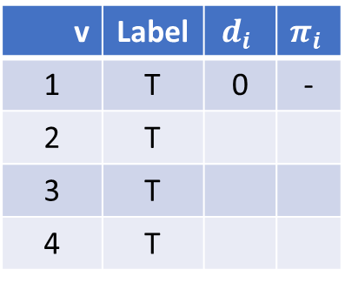

$$i$$
Permanent
-
$$i$$
Temporary
∞
-
2
-
v | Label | $$d_{i}$$ | $$π_{i}$$
1 | T | 0 | -
2 | T
3 | T
4 | T
1
1
0
∞
1
2
4
3
3
-5
-
∞

Slide 3
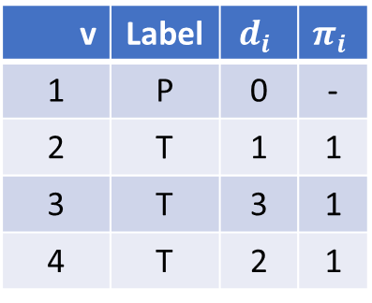
$$i$$
Permanent
1
$$i$$
Temporary
1
-
2
1
v | Label | $$d_{i}$$ | $$π_{i}$$
1 | P | 0 | -
2 | T | 1 | 1
3 | T | 3 | 1
4 | T | 2 | 1
1
1
0
2
1
2
4
3
3
-5
1
3

Slide 4
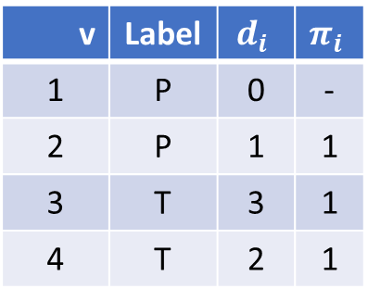
$$i$$
Permanent
1
$$i$$
Temporary
1
-
2
1
v | Label | $$d_{i}$$ | $$π_{i}$$
1 | P | 0 | -
2 | P | 1 | 1
3 | T | 3 | 1
4 | T | 2 | 1
1
1
0
2
1
2
4
3
3
-5
1
3

Slide 5
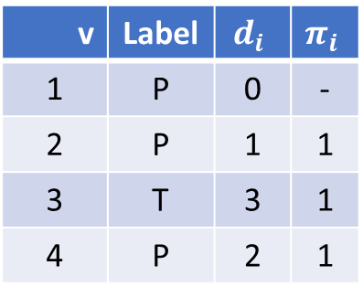
$$i$$
Permanent
1
$$i$$
Temporary
1
-
2
1
v | Label | $$d_{i}$$ | $$π_{i}$$
1 | P | 0 | -
2 | P | 1 | 1
3 | T | 3 | 1
4 | P | 2 | 1
1
1
0
2
1
2
4
3
3
-5
1
3

Slide 6
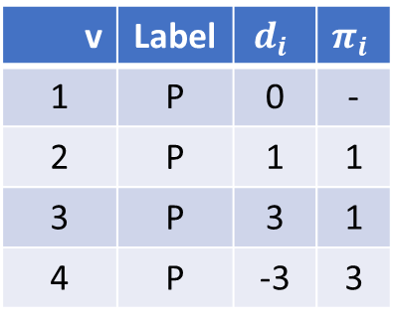
$$i$$
Permanent
1
$$i$$
Temporary
1
-
2
3
v | Label | $$d_{i}$$ | $$π_{i}$$
1 | P | 0 | -
2 | P | 1 | 1
3 | P | 3 | 1
4 | P | -3 | 3
1
1
0
-2
1
2
4
What is the best path from our table for 1 -> 2?
1-2 with distance 1
Is there a better path?
Yes 1-3-4-2 has a distance of -1.
Dijkstra delivered a suboptimal solution. i.e., it failed
3
3
-5
1
3

